Slide 1

Real-Time Heart Health Monitoring and Emergency Alert System
DISHA 4SF22CD018
SREYA P 4SF22CD047
TANISHA SALONI 4SF22CD052
THRISHA D BANGERA 4SF22CD054
under the guidance of
Mrs. Suchetha G
Assistant Professor
Department of Information Science & Engineering
at
at
SAHYADRI
College of Engineering & Management
Mangaluru – 575007

Slide 2
Project Introduction
Heart strokes are a leading cause of sudden death due to delayed detection and response.
Traditional monitoring methods lack real-time tracking and alert mechanisms.
This project offers a cloud-based system for continuous monitoring of vital signs (heart rate, BP, SpO₂, temperature).
Uses ESP32 microcontroller and sensors to collect and send data wirelessly to the cloud.
Enables remote access and instant alerts, improving early detection and patient care.

Slide 3
Literature Review
Paper no. | Title | Relevance to the Project | Inference
[1] | Medical alert system for remote health monitoring using sensors and cloud computing | It supports remote health monitoring using sensors and cloud to track vital signs and generate emergency alerts | Cloud and sensors together help in continuous health monitoring and quick alerts
[2] | A wearable mobihealth care system supporting real-time diagnosis and alarm | It enables real-time health monitoring and emergency alerts, similar to the goal of my project. | Wearable systems can provide continuous, real-time diagnosis and timely alerts to improve patient care.
[3] | Cardiac Care Assistance using Self Configured Sensor Network— a Remote Patient Monitoring System | It uses sensors for remote monitoring of patients’ heart health, which aligns with my project’s goal of tracking vital signs and sending alerts. | Self-configured sensor networks can effectively monitor cardiac health remotely and provide timely alerts for emergencies

Slide 4
Literature Review
Paper no. | Title | Relevance to the Project | Inference
[4] | Design of Low-Cost, Wearable Remote Health Monitoring and Alert System for Elderly Heart Patients | It focuses on a low-cost, wearable system to monitor heart health and send alerts, similar to my idea of remote patient monitoring. | Affordable wearable devices can help monitor elderly patients’ heart health and provide timely alerts to prevent emergencies
[5] | ECG alert: A Heart attack alert system | It provides early alerts for heart attacks, which aligns with my project’s aim to generate emergency alerts based on vital signs | Early detection and alert systems like ECG alert can save lives by notifying patients and doctors quickly during heart emergencies
[6] | IoT Based Real Time Heart Health Monitoring System | It uses IoT to monitor heart health in real time, similar to my project’s goal of continuous remote patient monitoring. | IoT technology enables real-time tracking of heart health, improving timely response to critical conditions.

Slide 5
Literature Review
Paper no. | Title | Relevance to the Project | Inference
[7] | A Health Monitoring System Using Smart Phones and Wearable Sensors | It uses smartphones and sensors for remote health monitoring. | Smartphones and sensors enable easy and continuous health tracking.
[8] | My Wear: A Smart Wear for Continuous Body Vital Monitoring and Emergency Alert | It is relevant because it monitors body vitals continuously and sends emergency alerts, like my project. | The system shows how smart wearables can improve timely health monitoring and alerting.
[9] | Wheats: A wearable personal healthcare and emergency alert and tracking system | It offers wearable health monitoring with emergency alerts and tracking, similar to my idea. | Wearable systems can help track health and provide quick alerts during emergencies.

Slide 6
Literature Review
Paper no. | Title | Relevance to the Project | Inference
[10] | Design a Monitoring Device for Heart-Attack Early Detection Based on Respiration Rate and Body Temperature Parameters | It uses vital signs like respiration and temperature to detect early signs of heart attacks | Monitoring key body parameters can help in early detection of heart-related emergencies.
[11] | A novel wireless sensor network deployment for monitoring and predicting abnormal actions in medical environment and patient health state | It uses wireless sensors to monitor patient health and detect abnormal conditions | Wireless sensor networks can effectively monitor and predict health issues in real time.
[12] | Wearable IoT (w-IoT) artificial intelligence (AI) solution for sustainable smart-healthcare | It combines wearable IoT and AI for smart healthcare. | AI with wearable IoT can enhance health monitoring by making it smarter and more responsive.

Slide 7
Literature Review
Paper no. | Title | Relevance to the Project | Inference
[13] | Machine learning-based smart wearable system for cardia carrest monitoring using hybrid computing | It uses machine learning and wearable devices to monitor cardiac arrest | Machine learning improves the accuracy and efficiency of detecting critical heart conditions in wearable systems.
[14] | Effective Diagnosis and Monitoring of Heart Disease | It focuses on diagnosing and monitoring heart disease | Continuous monitoring helps in early detection and better management of heart disease
[15] | Real-Time Elderly Healthcare Monitoring Expert System Using Wireless Sensor Network | It uses wireless sensors for real-time health monitoring of the elderly | Wireless sensor networks enable continuous and efficient health monitoring for elderly patients.

Slide 8
Literature Review
List of Research Gaps identified from the Literature Review
R1:Limited battery life and computational power in wearable health monitoring devices.
R2:Inconsistent real-time data transmission from wearable sensors to healthcare providers.
R3:Lack of seamless integration between wearable sensors and cloud platforms.
R4:Absence of reliable emergency alert mechanisms in many existing systems.
R5:Insufficient machine learning implementation for predicting critical health conditions.
R6:High cost of available smart healthcare systems, limiting their use in low-resource settings.
R7:Difficulty in monitoring multiple vital signs simultaneously with accuracy.
Outcome of the Research gaps shall be your problem statement

Slide 9
Literature Review
List of Research Gaps identified from the Literature Review
R8:Lack of user-friendly interfaces for patients and caregivers.
R9:Poor network coverage or data loss in remote health monitoring setups.
R10:Inadequate focus on elderly and high-risk patients who need constant supervision.
R11:Insufficient data security and privacy measures for sensitive health information.
R12:Limited scalability of existing systems for monitoring large patient populations.
R13:Infrequent or no updates of health records in real-time for physicians access.
R14:Few systems capable of functioning offline and syncing data when internet is available.
R15:Limited research on voice-based alerts for non-technical users during emergencies.

Slide 10
Problem Statement
Heart strokes are a major global health threat, often resulting in sudden death or long-term disability due to the lack of real-time monitoring and delayed medical response. There is a need for a smart, affordable system that can continuously monitor vital signs such as heart rate, blood pressure, oxygen saturation, and body temperature and send instant alerts to caregivers or healthcare providers, ensuring timely intervention and improved patient outcomes.
A smart, affordable real-time health monitoring system that continuously tracks vital signs and instantly alerts caregivers to enable timely medical intervention and reduce heart stroke risks.

Slide 11
Objectives
Ob1: To continuously monitor vital health parameters such as heart rate, blood pressure, oxygen saturation (SpO₂), and body temperature.
Ob2: To transmit real-time health data wirelessly to a cloud platform for remote access and centralized storage.
Ob3: To detect abnormal health conditions and generate instant alerts for caregivers or medical professionals.
Ob4: To provide a simple and user-friendly interface that allows users to easily view and understand their health status.

Slide 12
Expected Outcomes
Objective | Outcomes
Ob1 | O1:Integration of multiple sensors into a single wearable device. O2:Reduction in the need for manual health checks. O3:Real-time health data visualization on mobile or web applications.
Ob2 | O1:Reliable wireless transmission of health data to the cloud. O2:Secure centralized storage of patient health information. O3:Easy remote access to real-time data by doctors and caregivers.

Slide 13
Expected Outcomes
Objective | Outcomes
Ob3 | O1:Accurate detection of abnormal vital signs in real time. O2:Instant generation of alerts when critical conditions occur. O3:Faster response and intervention by caregivers or medical professionals.
Ob4 | O1:A clear and easy-to-use interface for health data display. O2:Improved user understanding of their current health status. O3: Increased user engagement and timely health monitoring.

Slide 14
Software Requirements
.
Software/Library | Version | Speed/Performance | Size(MB) | Variant | Quantity/Usage
Flutter | 3.10 | Fast UI Reading | ~100 MB | Stable | 1(Frontend Mobile App)
Python | 3.11 | Depends on module | ~25 MB | C Python | 1 (Backend anomly detection)
Node.js | 18.x | High-performance I/O | ~30 MB | LTS | 1(Backend API handling)
Firebase | 9.0+ | Realtime DB and alerts | ~1 MB | Modular | 1(Cloud storage/alerts)
MongoDB Atlas | 6.0 | High-speed NoSQL | N/A | Cloud-based | 1(Session/Data Storage
Twilio API | Latest | Real-time SMS alerts | N/A | Cloud service | 1(Notification)
Google Cloud Auth | Latest | Secure login/auth | N/A | OAuth | 1(Authentication service)

Slide 15
Hardware Requirements
Hardware Component | Version/Model | Speed/Performance | Size | Variant | Quantity/Usage
ESP32 Wi-Fi Module | ESP32-WROOM-32 | 240 MHz Dual Core | 18 mm x 25.5 mm | Dev Board | 1 (Main microcontroller + Wi-Fi)
Pulse Sensor | KY-039 / MAX30100 | 0–200 bpm (typical range) | Compact | Analog/Digital | 1 (Heart rate & SpO₂ monitoring)
Blood Pressure Sensor | MPX5050/Custom | 0–300 mmHg | Small | Analog | 1 (Blood pressure detection)
Temperature Sensor | LM35 / DS18B20 | ±0.5°C accuracy | ~TO-92 | Analog/Digita | 1 (Body temperature monitoring)
Power Supply | Power Supply | 3.7V–5V regulated | Small | Rechargeable | 1 (Power for ESP32 and sensors)
Jumper Wires | Male-Female | N/A | Standard | Mixed | 10–15 (Sensor connections)
Breadboard/PC | Standard | N/A | ~8 cm x 6 cm | Reusable/Custom | 1 (Prototyping sensor circuit)
Smartphone | Android/iOS | Min. 2GB RAM, Wi-Fi enabled | Varies | User's device | 1 (Frontend app interface)

Slide 16
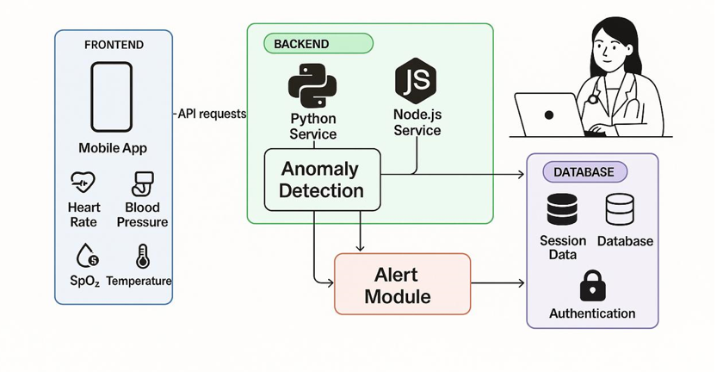
Proposed Architecture Diagram
Cloud Platform

Slide 17
Proposed Architecture Diagram
Items | Descriptions
Dataset | Real-time sensor data collected from users (Heart Rate, Blood Pressure, SpO₂, Temperature). No external dataset used; data is built through live monitoring.
Features | Continuous monitoring, anomaly detection, real-time alerts, and remote access via mobile application.
Methodology | Sensors collect vital signs → data sent via API to backend → anomaly detection → alert module triggers notifications → data stored in database.
Implementation | Frontend (Mobile App), Backend (Python & Node.js services), ESP32 microcontroller, Cloud database for data storage & authentication, alert system via SMS or app.
Testing | Functional testing of sensor data capture, alert generation under abnormal conditions, API and cloud connectivity testing, mobile app interface validation.

Slide 18
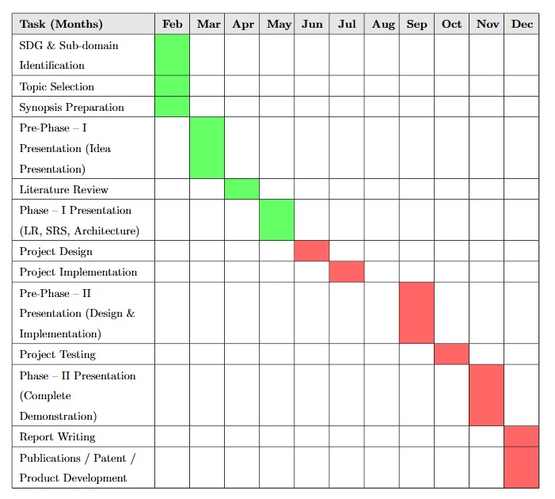
Gantt Chart

Slide 19
References
[1] Indumathy, N., and Kiran Kumari Patil. “Medical Alert System for Remote Health Monitoring Using Sensors and Cloud Computing.” International Journal of Research in Engineering and Technology 3.4 (2014): 884–888.
[2] Zheng, J. W., Z. B. Zhang, T. H. Wu, and Y. Zhang. “A wearable mobihealth care system supporting real-time diagnosis and alarm.” Medical & Biological Engineering & Computing 45.9 (2007): 877–885.
[3] Dhulipala, V. R. Sarma, and G. R.Kanagachidambaresan. “Cardiac Care Assistance using Self Configured Sensor Network—a Remote Patient Monitoring System.” Journal of the Institution of Engineers (India): Series B (2014). DOI: 10.1007/s40031-014-0084-1.
[4] Valliappan, S. P., Prithvi Raj Mohan B., and Rakesh Kumar S. “Design of Low-Cost, Wearable Remote Health Monitoring and Alert System for Elderly Heart Patients.” Proceedings of the IEEE International Conference on IoT and its Applications (ICIOT 2017), E.G.S. Pillay Engineering College, Nagapattinam, India, 2017. ISBN: 978-93-84893-49-4.
[5] Gusev, Marjan, Aleksandar Stojmenski, and Ana Guseva. “ECGalert: A Heart Attack Alerting System.” Communications in Computer and Information Science, vol. 778, 2017, pp. 27–38. Springer, doi:10.1007/978-3-319-67597-8_3.

Slide 20
[6] Raut, Shreemauli, Sahil Vahora, Viren Shah, Ronak Ranka, and Mohini Reddy. “IoT Based Real Time Heart Health Monitoring System.” International Research Journal of Engineering and Technology (IRJET) 8.4 (2021): 3902–3909.
[7] Gay, Valerie, and Peter Leijdekkers. “A Health Monitoring System Using Smart Phones and Wearable Sensors.” International Journal of ARM 8.2 (2007): 29–36.
[8] Sethuraman, Sibi C., Pranav Kompally, Saraju P. Mohanty, and Uma Choppali. "MyWear: A Smart Wear for Continuous Body Vital Monitoring and Emergency Alert." arXiv preprint arXiv:2010.08866 (2020).
[9] Kannan, Sowrirajan. "Wheats: A Wearable Personal Healthcare and Emergency Alert and Tracking System." European Journal of Scientific Research 85, no. 3 (2012): 382–393.
[10] Zahra, Isna Fatimatuz, I Dewa Gede Hari Wisana, Priyambada Cahya Nugraha, and Hayder J. Hassaballah. "Design a Monitoring Device for Heart-Attack Early Detection Based on Respiration Rate and Body Temperature Parameters." Indonesian Journal of Electronics, Electromedical Engineering, and Medical Informatics (IJEEEMI) 3, no. 3 (2021): 114–120.

Slide 21
[11] Singh, Gurdeep. "Wearable IoT (w-IoT) artificial intelligence (AI) solution for sustainable smart-healthcare." International Journal of Information Management Data Insights 5 (2025): 100291
[12] Manikandan, R., S. Arunprakash, Rakan A. Alsowail, and Tharani Pandiaraj. "A novel wireless sensor network deployment for monitoring and predicting abnormal actions in medical environment and patient health state." Alexandria Engineering Journal 119 (2025): 149–167
[13] Singh, Gurdeep. "Wearable IoT (w-IoT) artificial intelligence (AI) solution for sustainable smart-healthcare." International Journal of Information Management Data Insights 5 (2025): 100291
[14] Otoom, Ahmed Fawzi, et al. "Effective diagnosis and monitoring of heart disease." International Journal of Software Engineering and Its Applications 9.1 (2015): 143–156
[15] Almarashdeh, I., Alsmadi, M. K., Farag, T., Albahussain, A. S., Badawi, U. A., Altuwaijri, N., Almaimoni, H., Asiry, F., Alowaid, S., Alshabanah, M., Alrajhi, D., Al Fraihet, A., & Jaradat, G. (2019). Real-time elderly healthcare monitoring expert system using wireless sensor network (arXiv:1908.03518v1). arXiv. https://arxiv.org/abs/1908.03518v1

Slide 22
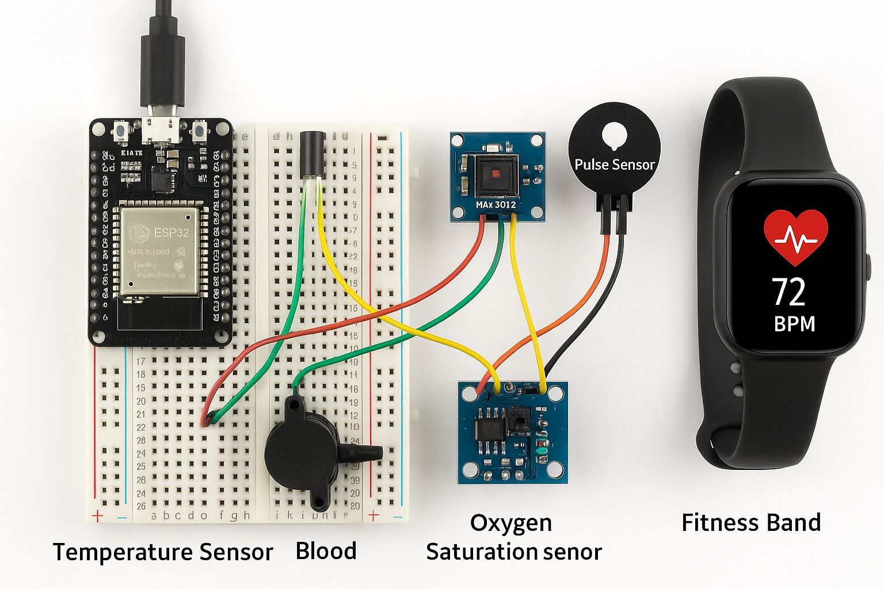


BAND
Sensor

